Slide 1
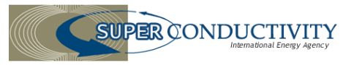
IEA Technology Collaboration Program on High-Temperature Superconductivity (IEA HTS TCP)
ExCo Meeting
30 January 2017
Milano, Italy

Slide 2
Outline
U.S. DOE Manufacturing Awards
Advanced Superconductor Manufacturing Institute

Slide 3
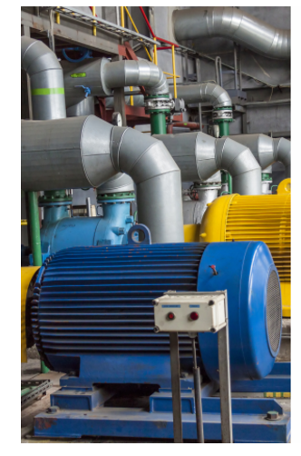
New Program Funded by U.S. DOE’s Advanced Manufacturing Office (AMO)
DOE announced $25 M for 13 projects aimed at advancing technologies for energy efficiency motors through applied R&D
DOE’s next generation electric machines projects will address the limitation of traditional materials and designs used in electric motor components by cost effectively enhancing their efficiency, improving their performance, and reducing weight
This effort will support innovative approaches that will significantly improve the technology in industrial electric motors
$14.5 M awarded to four HTS projects
AMSC, STI, University of Houston: $4.5 M each
Florida State University: ~$1 M
http://energy.gov/eere/amo/next-generation-electric-machines-project-descriptions

Slide 4




University of Houston Dr. Venkat Selvamanickam
Achieve I_{c} = 1750 A/12 mm at 65 K, 1.5 T through combination of thick films and high lift factor in Advanced MOCVD tool (10X wire)
Increase precursor to film conversion efficiency by 3X in Advanced MOCVD tool → to reduce cost to $20–30/m ($35–50/kA-m at 65 K, 1.5 T)
Scale up process to demonstrate 50 m long tape with I_{c} = 1750 A/12 mm at 65 K, 1.5 T
Design and fabricate and test sub-scale rotor coil at 65 K with high performance wire made by lower-cost, high throughput process
Team Partners:

Slide 5
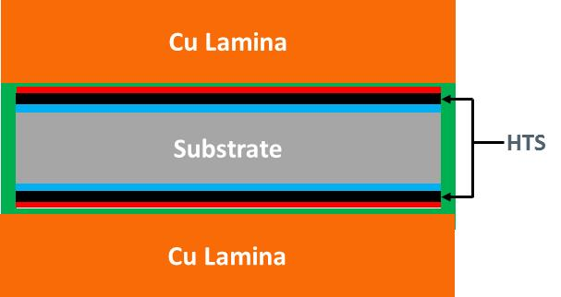

AMSC Dr. Martin Rupich
Technology Summary
Key Personnel
This project focuses on development of an innovative wire architecture that contains 2 HTS layers in one thin wire package. Each individual HTS layer, up to 1.5 μm thick, is ion irradiated to enhance the pinning performance at the targeted operating temperatures and fields for electric motors applications. This novel 2G wire architecture will be capable of carrying a critical current of nearly 1500 A/cm-w at 65K, 1.5T (perpendicular to the tape surface) and over 4000 A/cm-w critical current density at 30K, 1.5T (perpendicular to the tape surface). This innovative wire will be produced using low-cost, high-rate roll-to-roll manufacturing processes and is projected to significantly reduce the cost of state-of-the-art 2G HTS wire in terms of $/kA-m at operating conditions.
Martin Rupich and Srivatsan Sathyamurthy, AMSC
Qiang Li, Brookhaven National Laboratory
Vyacheslav Solovyov, Brookhaven Technology Group
Amit Goyal, University of Buffalo
Program Summary
Period of performance: 36 months
EERE funds: $ 4.5 M Cost-share: $ 1.125 M Total budget: $ 5.625 M
 | Key Milestones & Deliverables
Year 1 | Development of double layer architecture Optimization of ion irradiation for 65K, 1.5T Development of thicker MOD-based YBCO
Year 2 | Process integration Produce wire with I_{c} ~1500 A/cm-w at 65K,1.5T
Year 3 | Manufacture production length wire Demonstrate performance in 500 HP coil
Technology Impact
The innovative 2G wire architecture will result in the first practical, production length 2G wires that meet the demanding performance and cost requirements for broad-scale use in commercial electric machines.
A New Generation of High Performance 2G HTS Wire

Slide 6

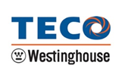


Superconductor Technologies Inc. (STI)
Ken Pfeiffer
Project Partners: TECO-Westinghouse Motor Company, Massachusetts Institute of Technology, University of North Texas
Proposed project goals;
Improve the current-carrying performance of 2G HTS wires to 1440A/cm-width at operating conditions of 65 Kelvin, & 1.5T
Reduce the manufacturing costs of 2G HTS wire by improving in-process yield
Technology Summary : STI’s superconducting wire manufacturing approach utilizes simplified, layered wire, architecture designed to scale with high yield and commercial volumes. STI’s wire architecture consists of two key manufacturing processes. First, the prepared substrate proceeds through an Ion Beam Assisted Deposition (IBAD) process in order to produce a template with the proper surface conditions. Then, the High Temperature Superconducting (HTS) materials are deposited onto the template using proprietary Reactive Co-evaporation Cyclic Deposition and Reaction (RCE-CDR) process. The technology in this project will focus on using RCE-CDR for; Increased Film Thickness, Intrinsic Pinning, Dopant Pinning, Superlattice growth and incorporate Precision Automatic Feedback compositional controls.
Completing this technology development will allow us to meet targets identified by DOE EERE.
Technology Impact: STI will transition from R&D to full scale production in the project scope of 3 years. In doing so, this will allow for the enabling technology to be rapidly introduced into Next Generation Electrical Machines utilizing high performance/low cost HTS wire.
Total Project: EERE funds $4.5M plus cost share $1.125M for a total of $5.625M over 3 years.

Slide 7
High Performance HTS wire can Enable Commercial Superconducting Motors at 65 K
 | Prod. Wire now | ARPA-E REACT 4X wire | AMO Next-gen EM Target wire
Ic @ 65 K, 1.5 T (A/12 mm) | 175 | 700 | 1750
Wire quantity for 5.5 MW motor* (km) | 13.5 | 3.4 | 1.3
Wire cost for 5.5 MW motor† ($(,000)) | 540 | 136 | 32.5
% of motor cost** | 154% | 39% | 9%
Increased cost of superconducting motor††: $70,000
Cost savings/year with superconducting motor ~ $ 47,000
(2% improved efficiency, 90% up time, $ 0.06/kW-h)
ROI ~ 1.5 years
* 4 mm wide wire
† Wire cost of $40/m for production wire and REACT wire, $25/m ($42/kA-m) for AMO Nextgen EM target wire
** using a conventional 6000 HP synchronous motor cost ~ $350 k
†† assuming additional $38 k cost for cryocooler and other technologies

Slide 8
Advanced Superconductor Manufacturing Institute (ASMI)
Did not secure FY2016 funding from the National Institute on Standards and Technology
If appropriations are available in FY2017, then ASMI stands a good chance of being funded
Workshop being held in Washington, DC on March 7-8, 2017
Discuss principles of the institute’s operation
Discuss how to handle intellectual property
Refine scope, goals, milestones, and risk mitigation plans for OEM driven projects

